Slide 1

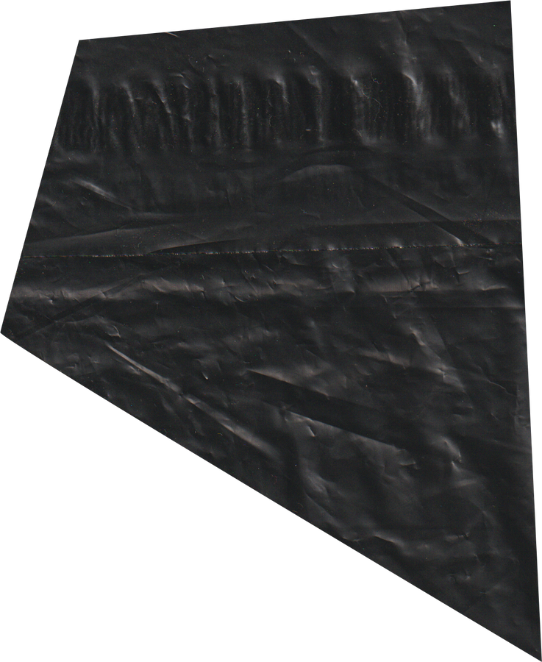

SMART WASTE MANAGEMENT SYSTEM
AN IOT BASED SMART BIN
EMPATHY MAP
23BAD126 VIJEY R S
23BAD088 PRITHIVIRAJ P S S
23BAD116 SRIDHA SRINIVASARAGHAVAN
23BAD115 SIJU N
23BAD012 AMIRTHA NANDAKUMAR

Slide 2
SAYS
THINKS
DOES
FEELS
Some days, we drive long routes for half-full bins, and sometimes they overflow when we arrive."
The smart system could make the job less stressful by giving clear instructions and reducing unnecessary work.
We follow fixed routes and check bin levels manually, which leads to wasted trips. I dispose of waste regularly, but bins sometimes overflow or aren’t emptied on time."
Frustrated by inefficient routes and wasted time, We're annoyed by inconsistent waste collection that creates unsanitary conditions
EMPATHY MAP

Slide 3
SAYS
Some days, we drive long routes for half-full bins, and sometimes they overflow when we arrive."
RESIDENTS
MUNICIPAL WASTE MANAGEMENT AUTHORITIES
"The bins are always overflowing, and the garbage trucks don't come on time."
"I've noticed that the collection trucks now come when the bins are full, not just on a fixed schedule."
“It's great that this system helps reduce waste and improve recycling rates."
"We used to struggle with scheduling routes efficiently, but now we rely on real- time data."
"The system helps us identify where we need to send trucks, reducing unnecessary trips."
"We are seeing higher recycling rates and less waste in the streets."

Slide 4
THINKS
The smart system could make the job less stressful by giving clear instructions and reducing unnecessary work.
RESIDENTS
MUNICIPAL WASTE MANAGEMENT AUTHORITIES
I wish the city would manage waste collection more effectively, with fewer overflows.
The city's new lot system seems to be working. It's more convenient and keeps the area clean.
I think this will have a positive impact on the environment, and I'll do my part by recycling more
The loT system is a game changer for optimizing waste collection and reducing operational costs.
We're reducing environmental impact and making our operations more efficient. This is the future of waste management.
If this continues to work well, we can expand it to cover more areas and optimize other city services.

Slide 5
DOES
We follow fixed routes and check bin levels manually, which leads to wasted trips. I dispose of waste regularly, but bins sometimes overflow or aren’t emptied on time."
RESIDENTS
MUNICIPAL WASTE MANAGEMENT AUTHORITIES
Dispose of waste regularly, but may experience issues when bins overflow or aren't emptied on time.
Use public bins regularly and notice cleaner surroundings and fewer incidents of overflowing waste.
Participate in local recycling initiatives, knowing that waste collection is optimized for sustainability.
Implement loT-enabled smart bins and oversee the optimization of waste collection routes through the fleet management system.
Monitor waste collection performance through real- time dashboards and adjust strategies based on data analytics.
Collect and analyze data to improve recycling rates, predict future waste patterns, and manage resources more effectively.

Slide 6
FEELS
Frustrated by inefficient routes and wasted time, We're annoyed by inconsistent waste collection that creates unsanitary conditions
RESIDENTS
MUNICIPAL WASTE MANAGEMENT AUTHORITIES
Annoyed when waste collection is inconsistent, leading to unsanitary conditions.
Pleased that the bins are being emptied efficiently, without regular overflows.
Proud to live in a city that's more eco- friendly and innovative
Relieved to have better control over waste collection operations and to minimize resident complaints.
Confident that the system will help reduce fuel costs and improve service quality.
Proud of the environmental and operational improvements that loT has enabled.

Slide 7
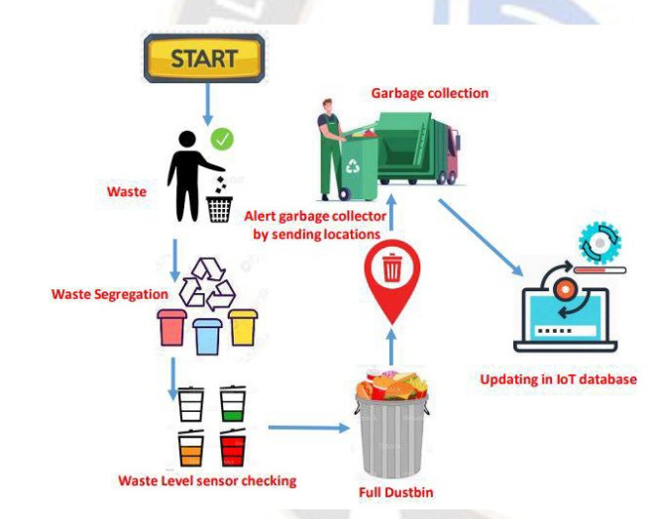
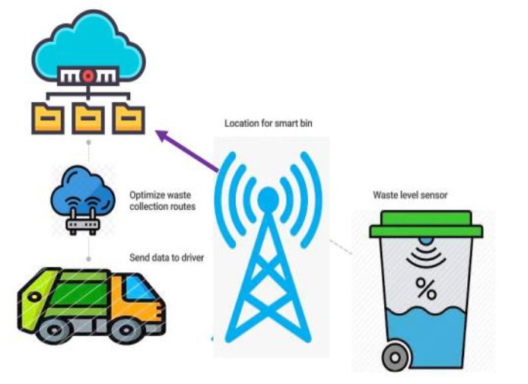
INSIGHTS
A survey of waste collection workers revealed that 40% reported spending more than 30% of their time driving to bins that are not full.
Approximately 70% of waste collection workers believe that implementing technology like real-time tracking would enhance their efficiency and job satisfaction.
A study found that 60% of residents have experienced overflowing bins at least once a month, leading to complaints and a perception of poor service.

